Slide 1

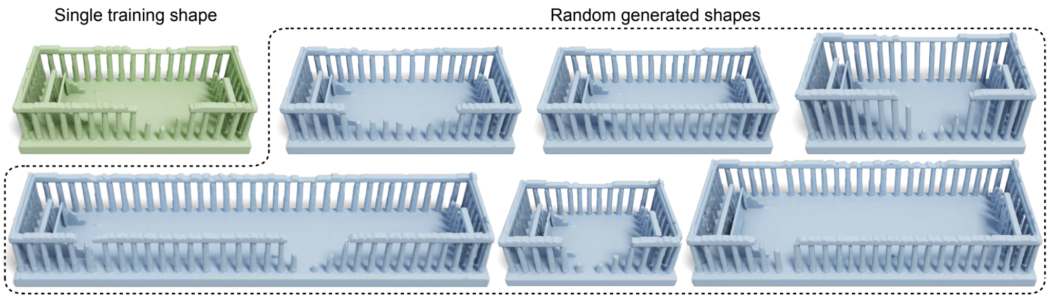
“Learning to Generate 3D Shapes from a Single Example ” tutorial Ambra Jin, supervisor Shilpa Kancharla
Tensorflow
[1]

Slide 2
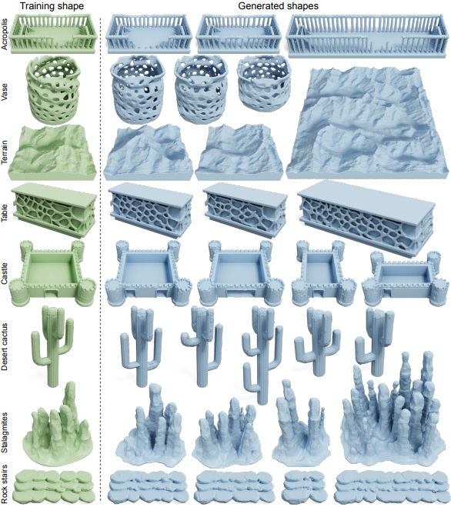
Introduction: context
Tensorflow
single example
capturing shape features
across different scales
generation of completely different shapes
[1]
Notes:
The paper introduces a deep generative model that can learn and generate 3D shapes from a single input shape, all without requiring manual annotation or external data. The primary objective of this model is similar to 2D texture synthesis, a technique for generating various textures from a single example. However, this model goes beyond just creating static 3D textures; it aims to generate a wide range of shape variations while maintaining the overall structure of the original input shape. This means it can produce multiple unique shapes based on a single input example, making it a versatile tool for 3D shape generation. This paper introduces the first deep generative model capable of creating new 3D shapes from just a single example while preserving shape characteristics at various scales. The paper demonstrates the model's ability to generate diverse 3D shapes across different categories.

Slide 3
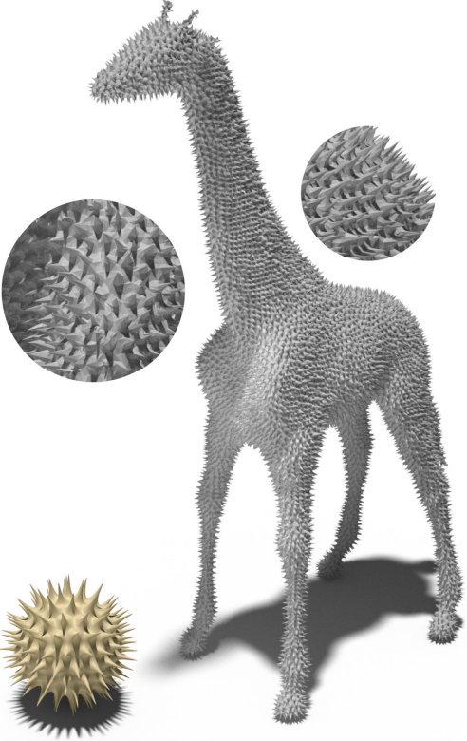
Introduction: state of art
Tensorflow
General deep generative models for 3D shapes
From a single example
DGTS [2]
[2]
Notes:
Existing GANS learn to produce 3D shapes in different representations, including voxels, point clouds , meshes, implicit functions , multi-charts, structural primitives, and parametric models . Nearly all these methods are trained on a large dataset of category-specific 3D shapes. In this paper, instead of learning shape distributions from a large dataset, they focus on learning shape features across multiple scales from a single 3D shape.
In several recent works, researchers start to explore generative models that are learned from a single example in various data domain, such as images , videos, audio, 3D meshes and motion sequences
DGTS [from 2020] is the sole previous work focused on deriving a generative model from a single 3D shape. This approach uses a convolutional network on triangle meshes to predict vertex displacement after dividing the shape into smaller parts. However, it primarily targets geometric texture transfer, hence being confined to unchanging and consistent features in a shape. Additionally, the generated shapes are bound by the input's shape's structure and organization. In contrast, their proposed method operates with a voxel representation, enabling it to capture geometric features across various scales and generate samples with distinct topologies from the input shape.
The image is from the DGTS paper: it learns local geometric textures from a reference mesh (gold) and transfers it to a target mesh (giraffe)

Slide 4
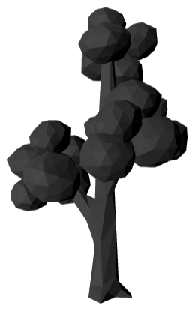
Introduction: motivation
Tensorflow
No Need for Large Datasets
Publicly Available Examples
Github repository in Pytorch to compare
Notes:
I only found a few 3D datasets available online the only one containing thousands of samples are
the COMA dataset for 3D facial scans, but you have to register and might not be available for commercial licenses.
ShapeNet dataset, but it requires approval “for non-commercial research and educational purposes”.
Whereas the paper’s Github repo already provides the links to the individual models.
On the right: this is the input I chose provided by the paper, an elm tree

Slide 5
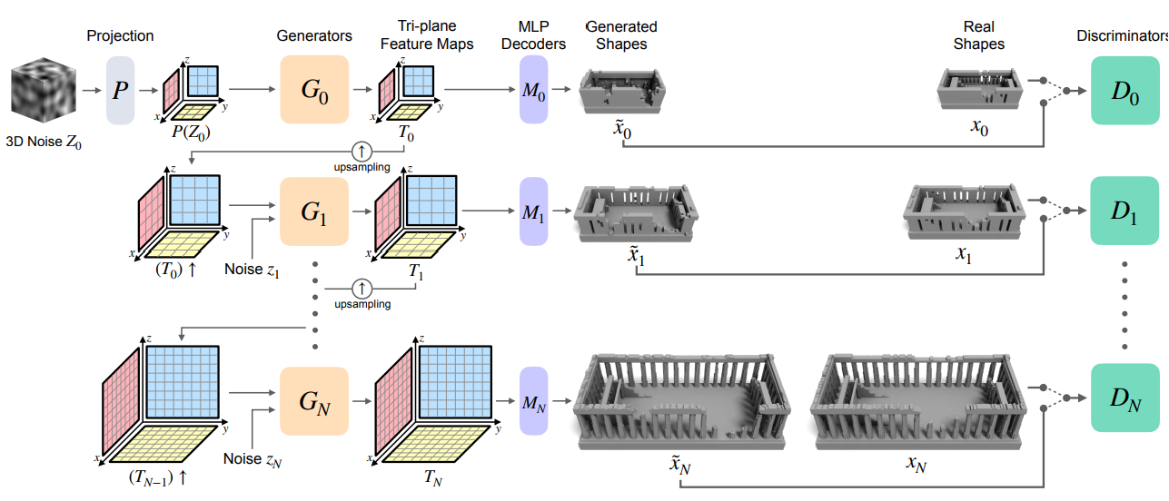
Methods
Tensorflow
This is display text it is not here to be read
This is display text it is not here to be read
This is display text it is not here to be read
This is display text it is not here to be read
Notes:
The model is structured as a pyramid, consisting of a sequence of generators {𝐺𝑖} and discriminators {𝐷𝑖}. It is trained on a multi-level voxel pyramid {𝑥𝑖} derived from a single reference shape. The training process is progressive, starting from the coarsest level (top) and progressing to the finest scale (bottom). We take the input shape 𝑥 and create a series of voxelized versions, forming a voxel pyramid {𝑥0, ..., 𝑥𝑁}, in my case N = 1. Each 𝑥𝑖 represents a voxelized variation of the original shape 𝑥, with different resolutions based on a user-specified downsampling factor 𝑟 (<1), for me is r = 0.5. All these 𝑥𝑖 representations are generated independently.
Shape generation begins with the generation of a random 3D noise vector 𝑍0, which has the same dimensions as the coarsest voxel grid 𝑥0. This initial noise vector 𝑍0 undergoes a projection process using a network 𝑃, which operates on three feature planes. This projection results in the creation of an initial tri-plane feature map denoted as 𝑃(𝑍0).
The generated tri-plane feature map 𝑃(𝑍0) is then input into the first generator 𝐺0. Each subsequent generator 𝐺𝑖, associated with a specific level 𝑖, produces a tri-plane map denoted as 𝑇𝑖. This tri-plane map is subsequently upsampled and serves as the input for the generator at the next level.
In parallel with the generator training, a discriminator 𝐷𝑖 corresponding to each level 𝑖 is trained. These discriminators aim to distinguish individual patches within the generated shape 𝑥˜𝑖 (presented in a voxelized representation) from their corresponding patches in the original shape 𝑥𝑖. This process occurs at each level of the pyramid, facilitating the learning of shape features across multiple scales.

Slide 6
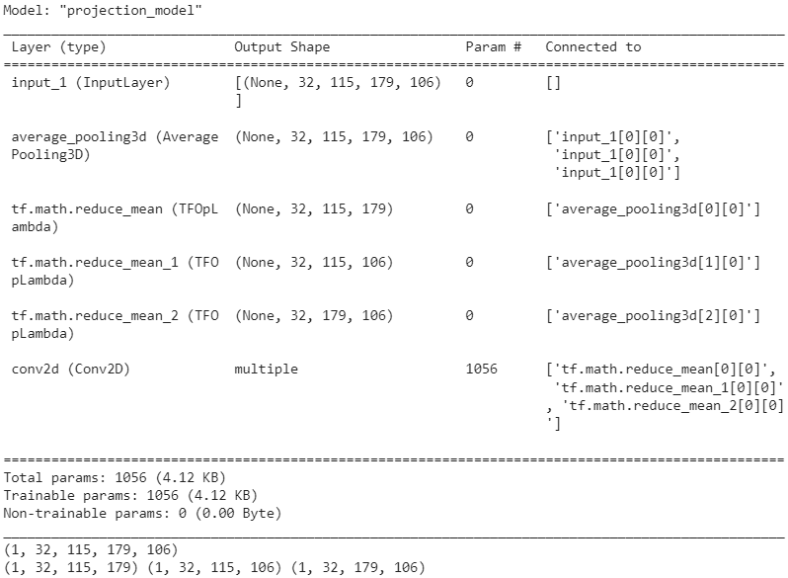
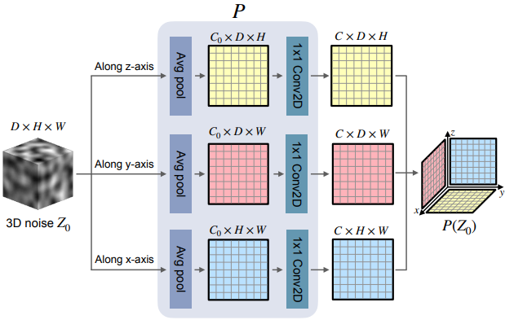
Methods : P
Tensorflow
Paper My code
Notes:
Projection (for each plane) AdaptAvgPool3D output channels 8, Conv2D output channels 32 kernel and stride size (1, 1) (1, 1)
My original input shape is a tensor of a gaussian distribution. The input size is (115, 179, 106) the same as the 3d model I chose, my outputs are 3 initial tri-plane feature map 𝑃 (𝑍0). Implemented my own Adaptive average 3d Pooling, as tf only has adaptive pooling

Slide 7
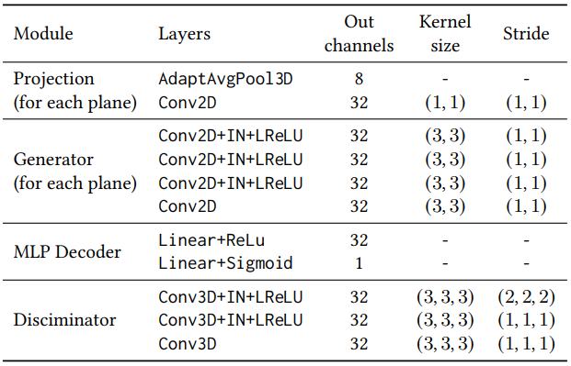
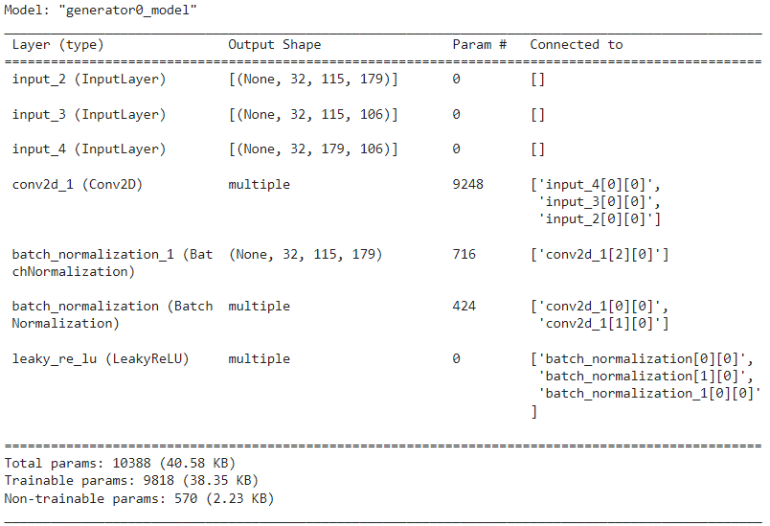
Methods: Generator 0
Tensorflow
Paper My code
Notes:
Generator 0 takes only one input, the triplane map . 𝐺0 produces a tri-plane map 𝑇0 through 𝑇0 = 𝐺0(𝑃 (𝑍0)).
For each triplane map it computesConv2D+IN+LReLU 32 (3, 3) (1, 1). Output shape is (115, 179) (115, 106) (179, 106)

Slide 8
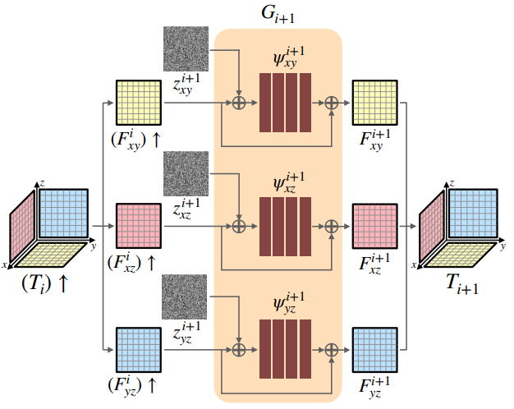
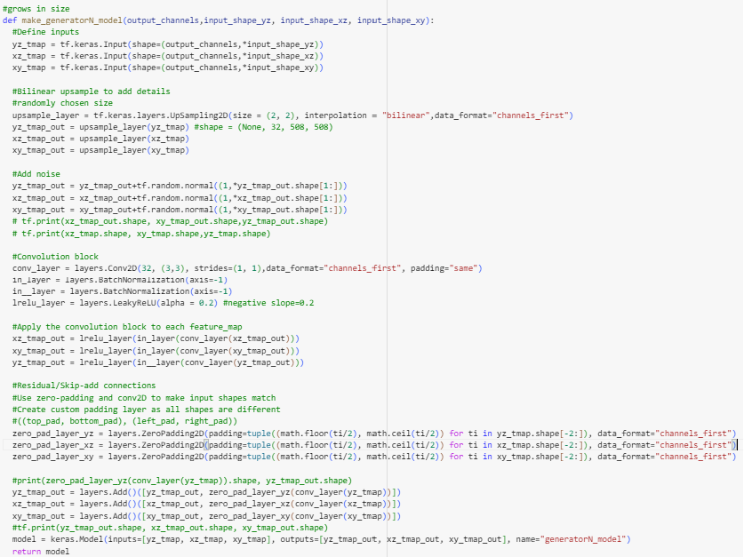
Methods: Generator N
Tensorflow
Paper My code
Notes:
To improve the quality of the upsampled tri-plane feature map 𝑇𝑖 obtained from the previous scale 𝑖, we introduce three distinct noise maps. These noise maps serve as input to three separate 2D convolutional networks, with each network composed of 4 convolutional blocks utilizing a 3 × 3 kernel. Within each of these networks, a skip connection is employed. This connection combines the input feature maps with the network's output, resulting in the generation of the final output of 𝐺𝑖+1, denoted as 𝐺𝑖+1(GN).
to remind my input resolution is (115, 179, 106) for G0, for GN is (230, 358, 212) (r = 0.5)

Slide 9
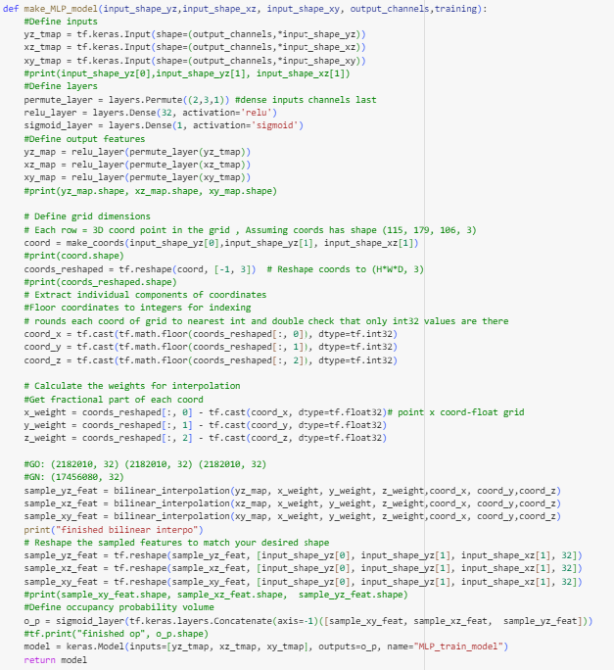
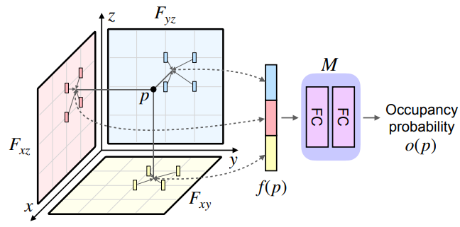
Methods: MLP
Tensorflow
Paper My code
Notes:
A point in space, represented as 𝑝,is projected onto three 2D custom grids to obtain coordinates, such as 𝑝𝑥 𝑦, 𝑝𝑥𝑧, and 𝑝𝑦𝑧. These coordinates are bilinear interpolated with the tri-plane feature maps (𝐹𝑥 𝑦, 𝐹𝑥𝑧, 𝐹𝑦𝑧)to obtain the corresponding feature value. They are then concatenated and fed into theMLP 𝑀 to calculate 𝑜 (𝑝). O(p) is the probability of 𝑝 being occupied by the 3D shape and represents the generated shape.
My output shape is the same as my input shape, but with a batch dimension, which can be squeezed out. The output volume is then reconstructed using Marching Cube algorithm

Slide 10
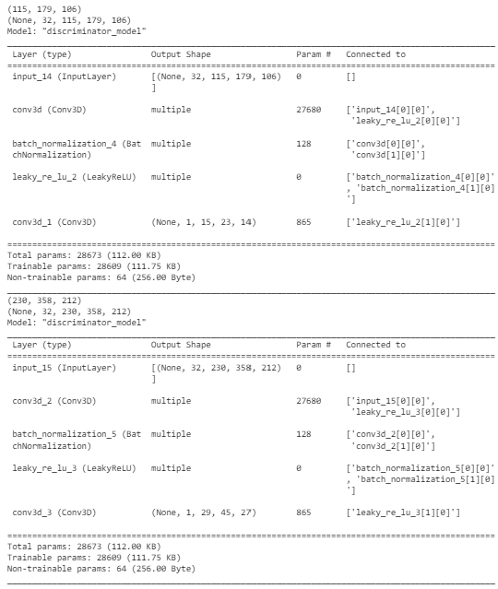
Methods: Discriminator
Tensorflow
Paper My code
Notes:
In our GAN hierarchy, discriminators process voxelized shapes in a uniform structure with 3D convolutional layers. Each layer uses a 3 × 3 × 3 kernel, and the first layer reduces the input grid size. These discriminators classify a 3D score map, that defines patches as fake or real. They are memory-efficient since they are only used during training and are trained one at a time, reducing memory requirements compared to the generators.The output channel is actually 1. My output score map is (15, 23, 14) for x0 and for xN(29, 45, 27)

Slide 11
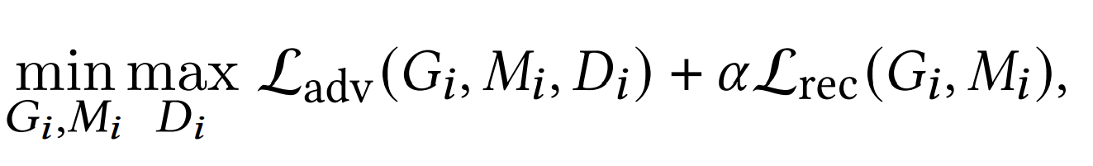
Methods:Loss (discriminator)
Tensorflow
Paper
My code (according to his repository)
mean(real score map)
mean(generated score map)
loss1 = generated loss-real loss
loss = loss1+gradient penalty
Notes:
it has as inputs the generator, the MLP and the discriminator
compute generated loss
compute real loss
loss1 = generated loss-real loss
loss = loss1+gradient penalty

Slide 12
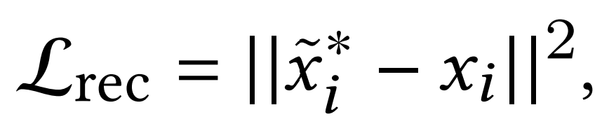
Methods:Loss (generator)
Tensorflow
Paper
My code (according to his repository)
mean(generated score map)
MSE
loss = generated loss+scaled MSE
Notes:
it has as inputs the generator, the MLP and the discriminator
compute generated loss = adversarial term
compute mse between real input voxels and generated voxels
loss = generated loss+scaled by alpha MSE

Slide 13
Results and discussion
Tensorflow
Differences
His repo/paper
downsampling r = 0.75
training scale = 9
Voxelisation = Binvox
Training at each scale is saved first
My code (according to his repository)
downsampling r = 0.5
training scale = 4
Voxelisation = Trimesh
Trained directly on all scales
Notes:
There are three key differences between his repository and my project:
Resolution Levels: As the training is progressive across resolution levels between 1 level of resolution to the next one, the voxels are downsampled from shape N to shape 0. He used a downsampling factor of 0.75. However, as the generator N upsamples the feature maps making them twice the size we used r = 0.5.
Training Levels: The paper mentions resizing dimensions to be at least 15 voxels. With r = 0.5, we achieved only 4 training levels (otherwise it would have been too big and RAM consuming), while his different downsizing ratio allowed for 9 training levels.
Voxelization Method: Our pre-processing approach differed, as he used Binvox, and I utilized trimesh, with Binvox being unavailable for Windows.
These distinctions affected the voxelization process and the training process.

Slide 14
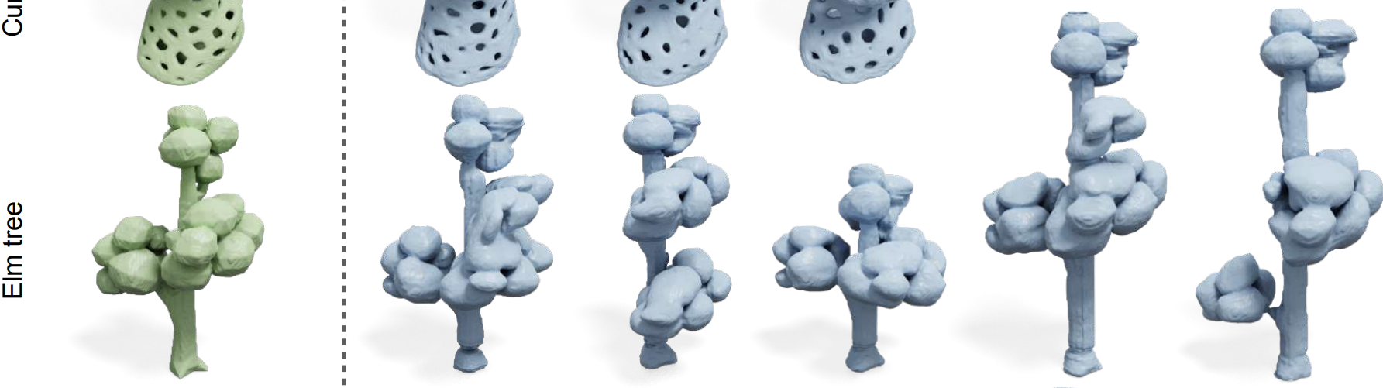
Results and discussion
Tensorflow
Paper
Notes:
These are the random generation the paper was able to achieve. Unfortunately, I am not able to run his repository on Colab, as I do not have a local GPU, and don’t have enough space on my drive to mount the entire repo on my Colab

Slide 15
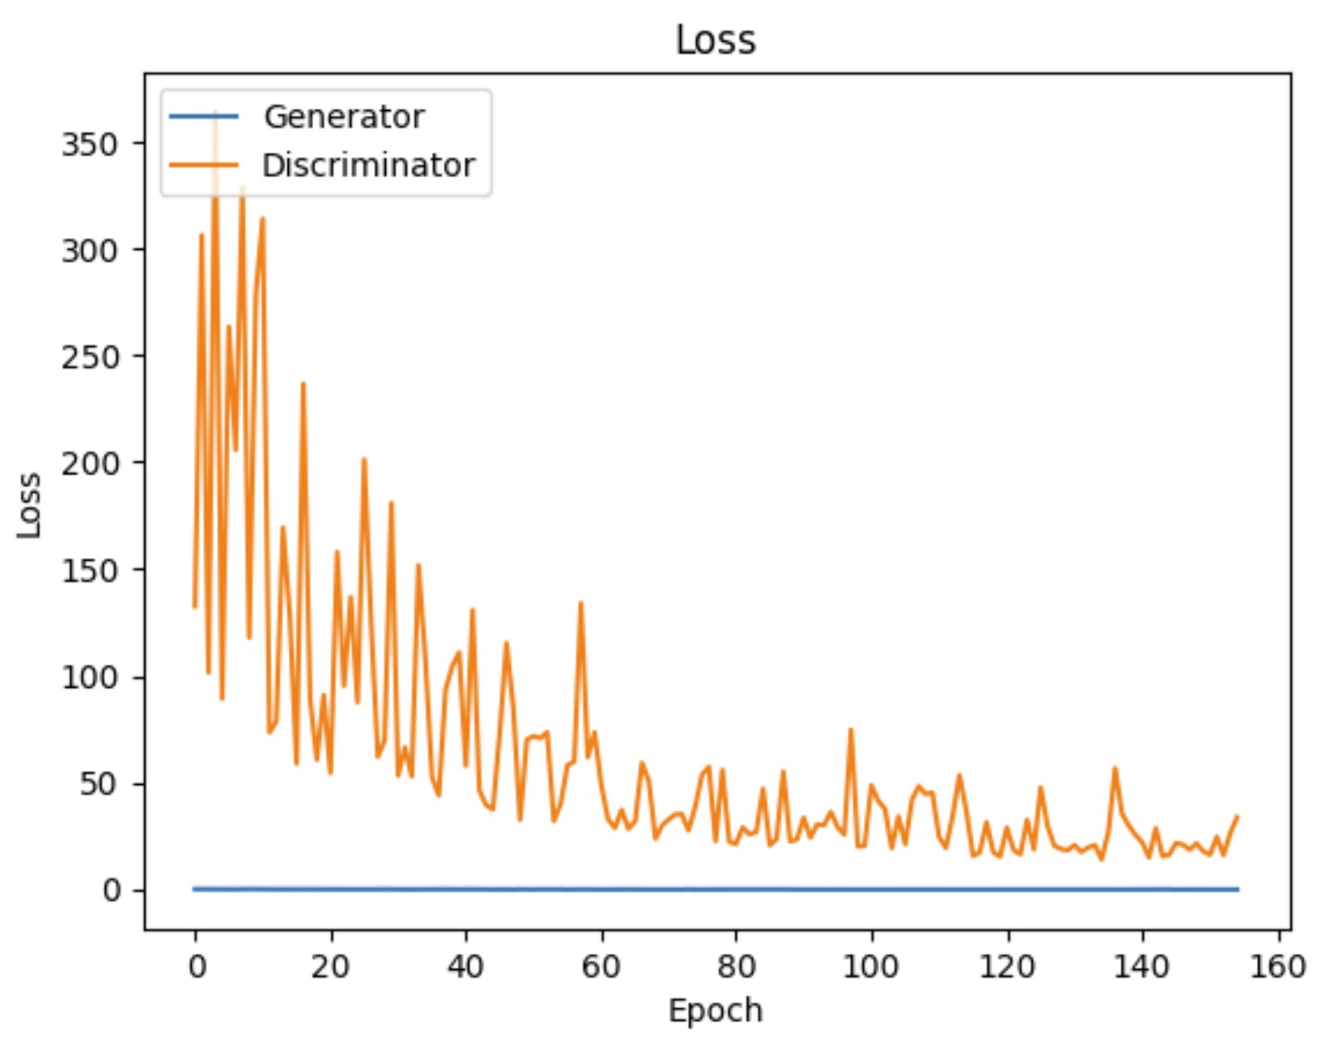
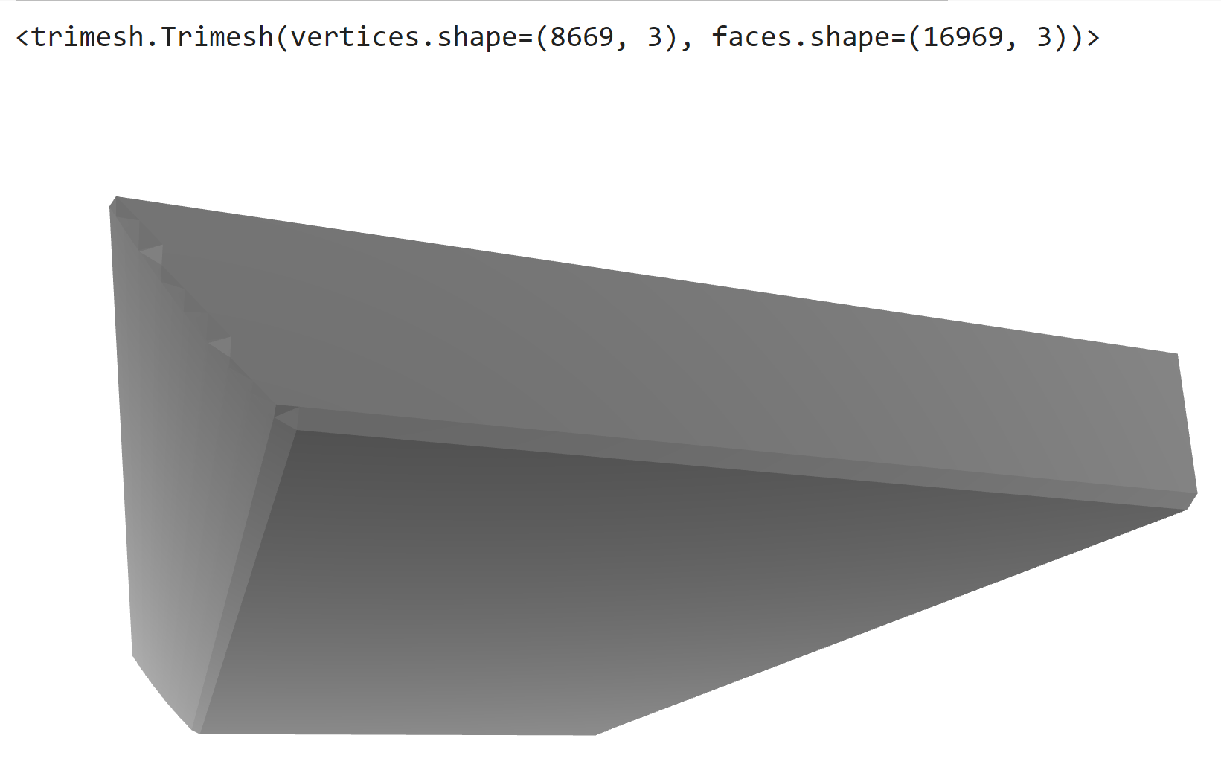
Results and discussion
Tensorflow
My code
Using only 1 training scale at full size
Notes:
Using only 1 training scale at full size
on the left: actually both losses decreased at different scale. It took 17.4GB of GPU RAM to run the the entire 2000 epochs. On the right the generated shape. As it’s only 1 training scale, I expect this to be normal as it was not able to capture such detailed shape as the tree

Slide 16
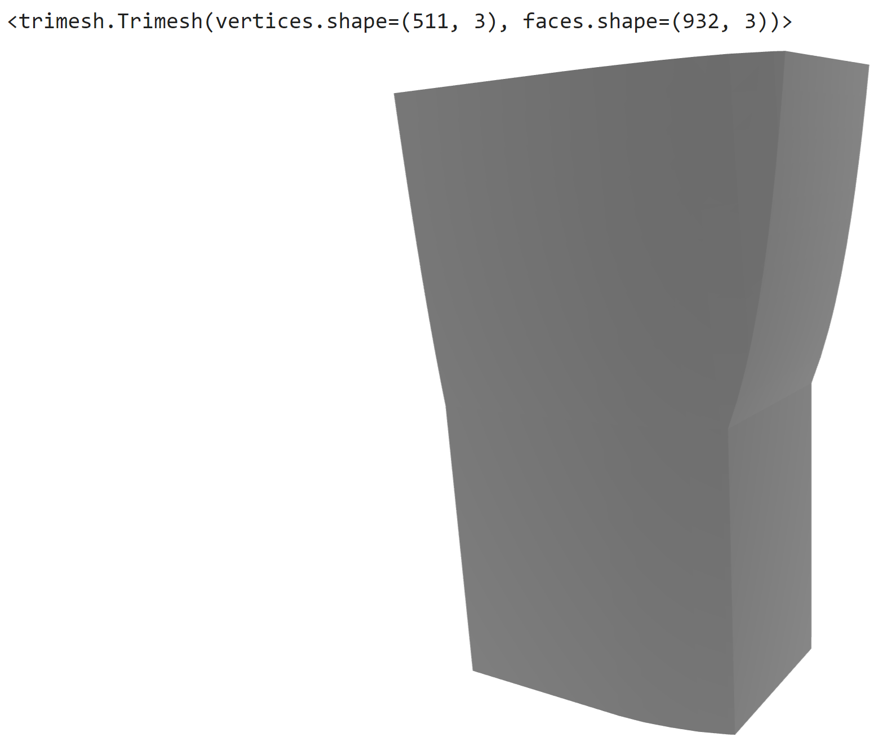
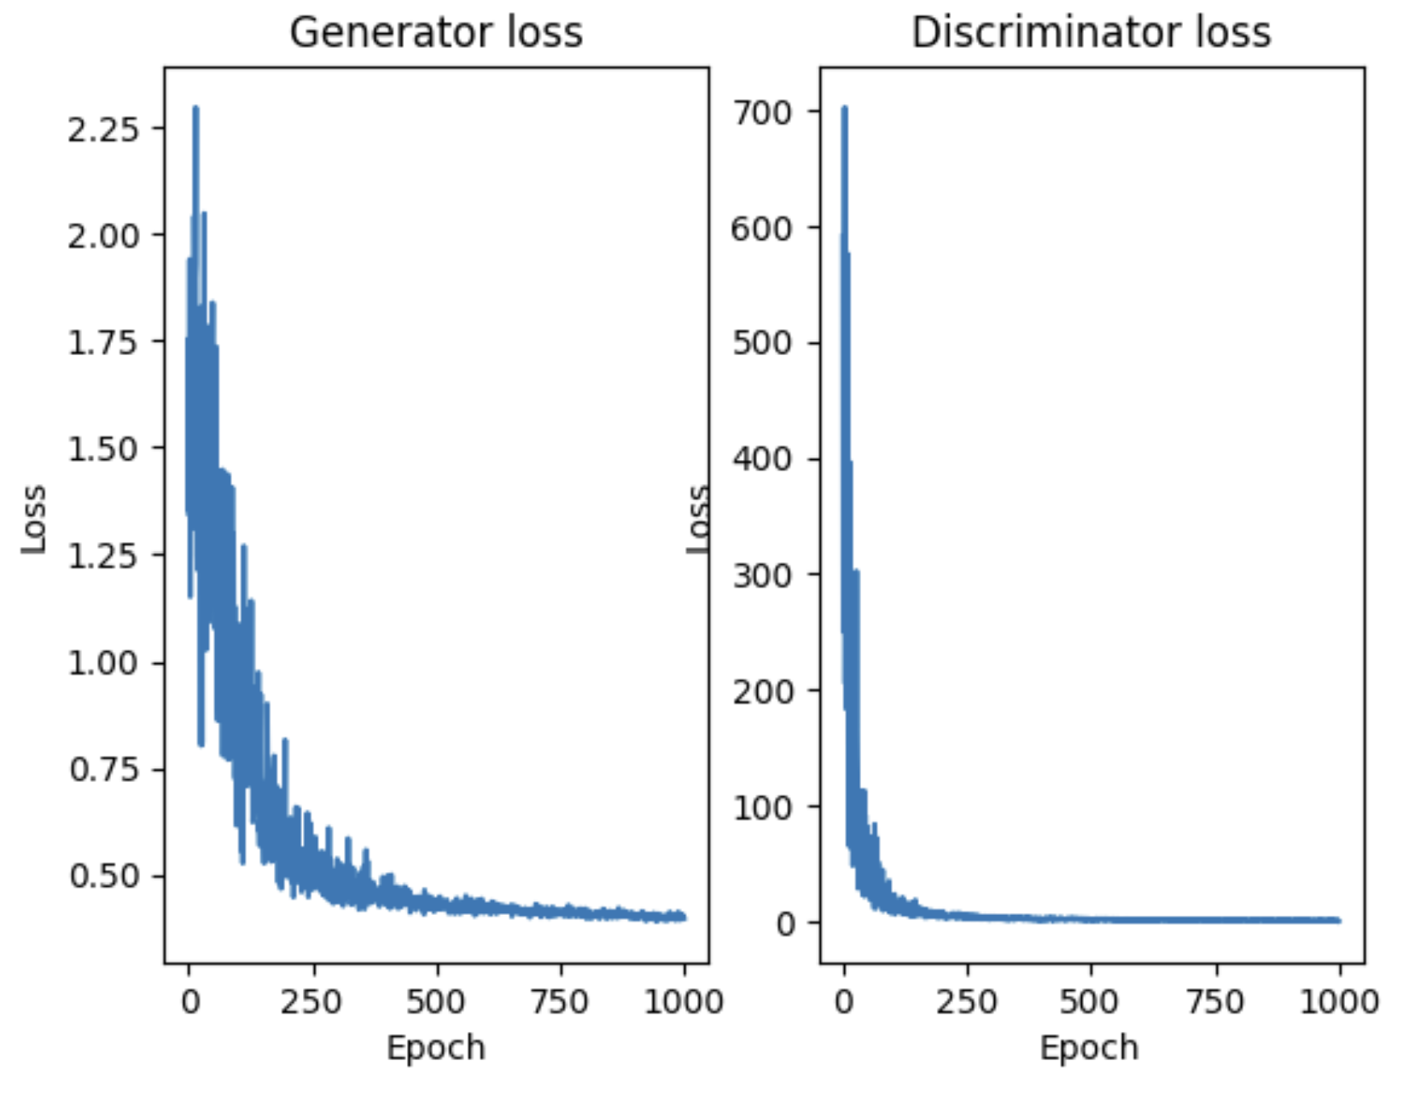
Results and discussion
Tensorflow
My code
Using only 4 training scales
Notes:
Using only 4 training scales
on the left: actually both losses decreased within 1000 epochs. I ran out of GPU computing units to finish running 2000 iterations.On the right the generated shape. As it’s 4 training scale, the generated shape looks more like a tree trunk

Slide 17
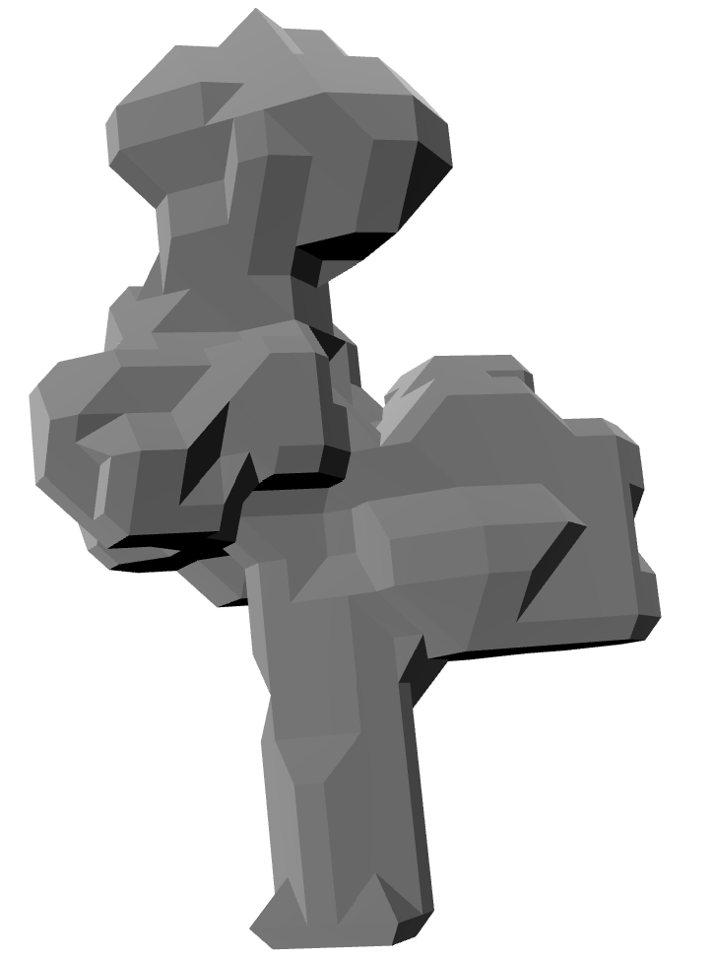
Results and discussion
Tensorflow
My code
Using only 4 training scales
Notes:
Using only 4 training scales
on the left: the elm tree at my coarsest training scale

Slide 18
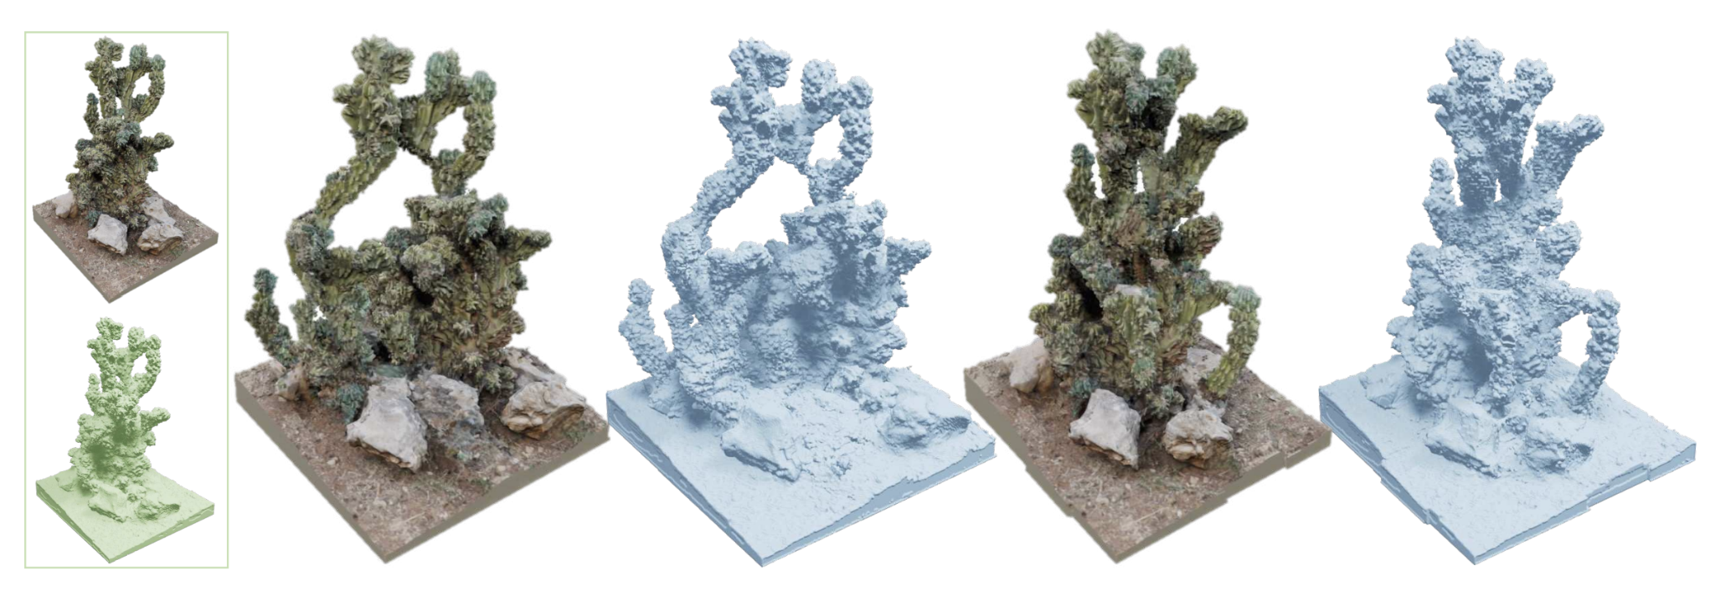
Conclusion
Tensorflow
Replicated all the main steps
Successfully explained and dismantled main components
Future directions: compare his work with “Patch-based 3D Natural Scene Generation from a Single Example ”
Notes:
As a summary
I Replicated all the main steps mentioned in the paper and compared to the repo, followed religiously all the equations mentioned and received some clarification from the author himself
Successfully showed how to preprocessed and implement the main structure: including the voxelisation, all the networks, explanation of its main architecture
As future direction it would be interesting to compare the paper to a newly came out paper called“Patch-based 3D Natural Scene Generation from a Single Example ”, which even though it had exact same claims, it did not provide comparison implementation with the first paper. They both use hierarchical training method. The second one introduced a Generative Patch Nearest-Neighbor module that maximizes the bidirectional visual summary between the input and output.

Slide 19
References
Tensorflow
[1] Wu, R. and Zheng, C., 2022. Learning to generate 3d shapes from a single example. arXiv preprint arXiv:2208.02946.
[2] Amir Hertz, Rana Hanocka, Raja Giryes, and Daniel Cohen-Or. 2020. Deep Geometric
Texture Synthesis. ACM Trans. Graph. 39, 4, Article 108 (2020). https://doi.org/10.
1145/3386569.3392471
[3] Li, W., Chen, X., Wang, J. and Chen, B., 2023. Patch-based 3D Natural Scene Generation from a Single Example. In Proceedings of the IEEE/CVF Conference on Computer Vision and Pattern Recognition (pp. 16762-16772).

